Slide 1
EECT 112-51C
MR. TOTH
FALL 2014
LAB
NOTEBOOK
BY:
ALCIDES SEGOVIA

Slide 2
Labs:
1 – AND & OR Gate
2 – NAND Alternative
3 – Mid-Term
4 – Binary Counter
5 – BASIC Stamp 1 – LED flasher
6 – BASIC Stamp 2 – Temp Sensor/Heater

Slide 3
Equipment
Digital Multimeter (DMM)
Function Generator
Oscilloscope (a.k.a. scope)
Power Supply (fixed and programmable)
Solderless Breadboard
Protoboards
Multisim (Simulation tool in class)
Excel

Slide 4
#1 - AND & OR Gates LAB
Show the basic functions of AND & OR gates
Show Multisim Schematic of AND & OR gates
Wire Elvis to display power output of AND & OR gate.

Slide 5
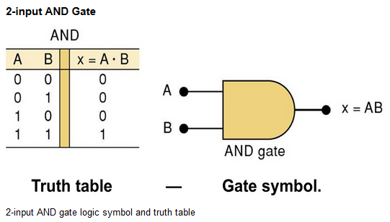
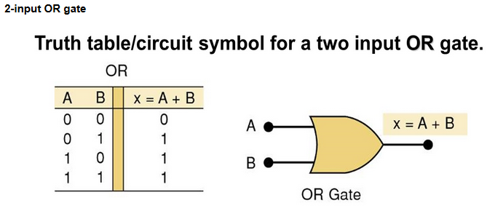
#1 - AND & OR Gates Functions
The AND operation is similar to multiplication:
The • sign does not stand for ordinary multiplication—it stands for the AND operation. x is true (1) when A AND B AND C are true (1)
An OR gate is a circuit with two or more inputs, whose output is equal to the OR combination of the inputs.

Slide 6
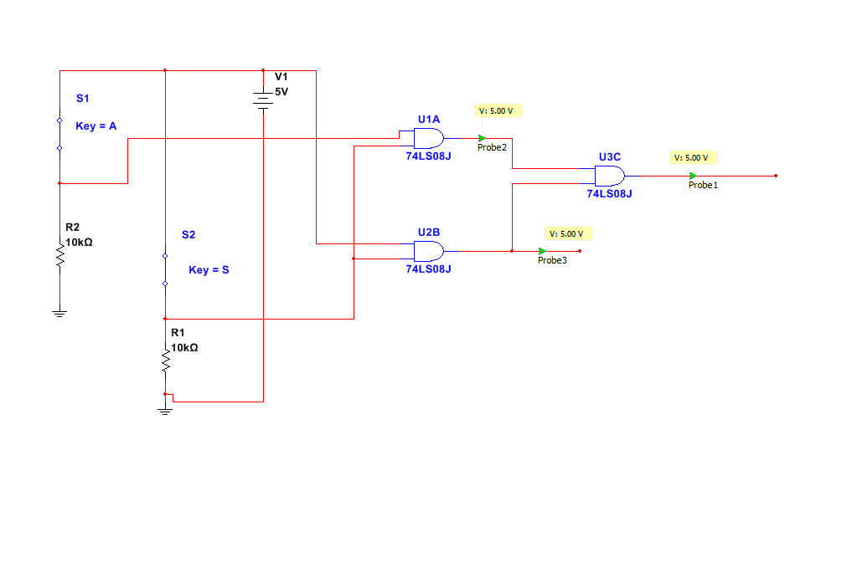
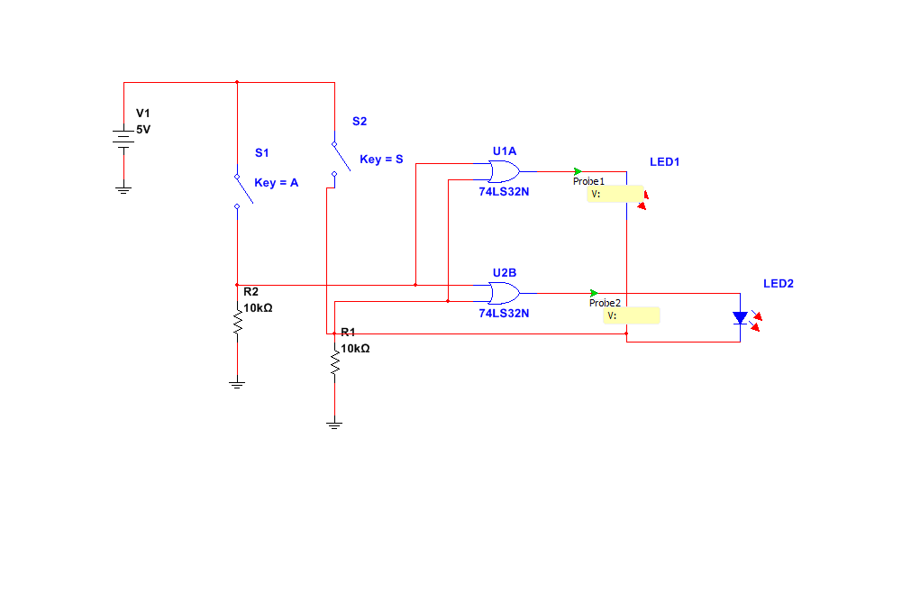
#1 - AND & OR Gates
Schematics on Multisim

Slide 7
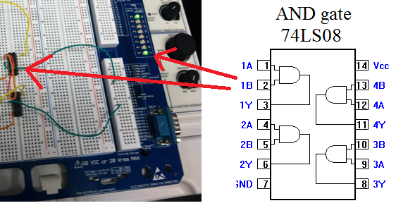
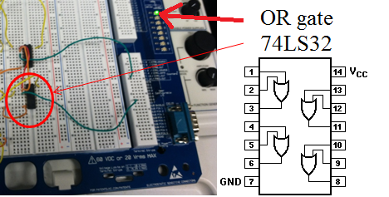
#1 - AND & OR Gates
IN THE LAB

Slide 8
#2 - NAND ALTERNATIVE Lab
Show the basic functions of NAND gates.
Show Multisim Schematic of NAND
Wire Elvis to display power output of NAND gates.

Slide 9
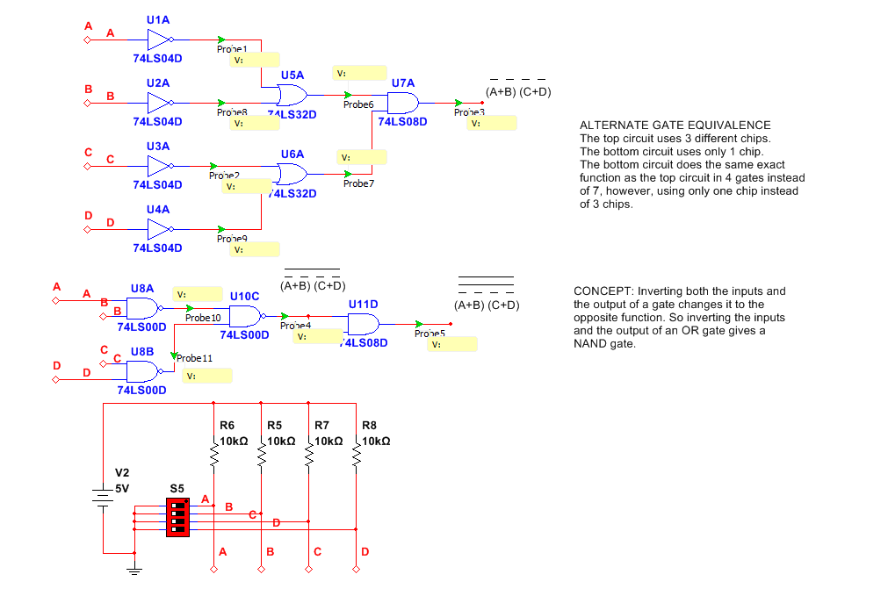
#2 - NAND ALTERNATIVE Schematic on Multisim

Slide 10
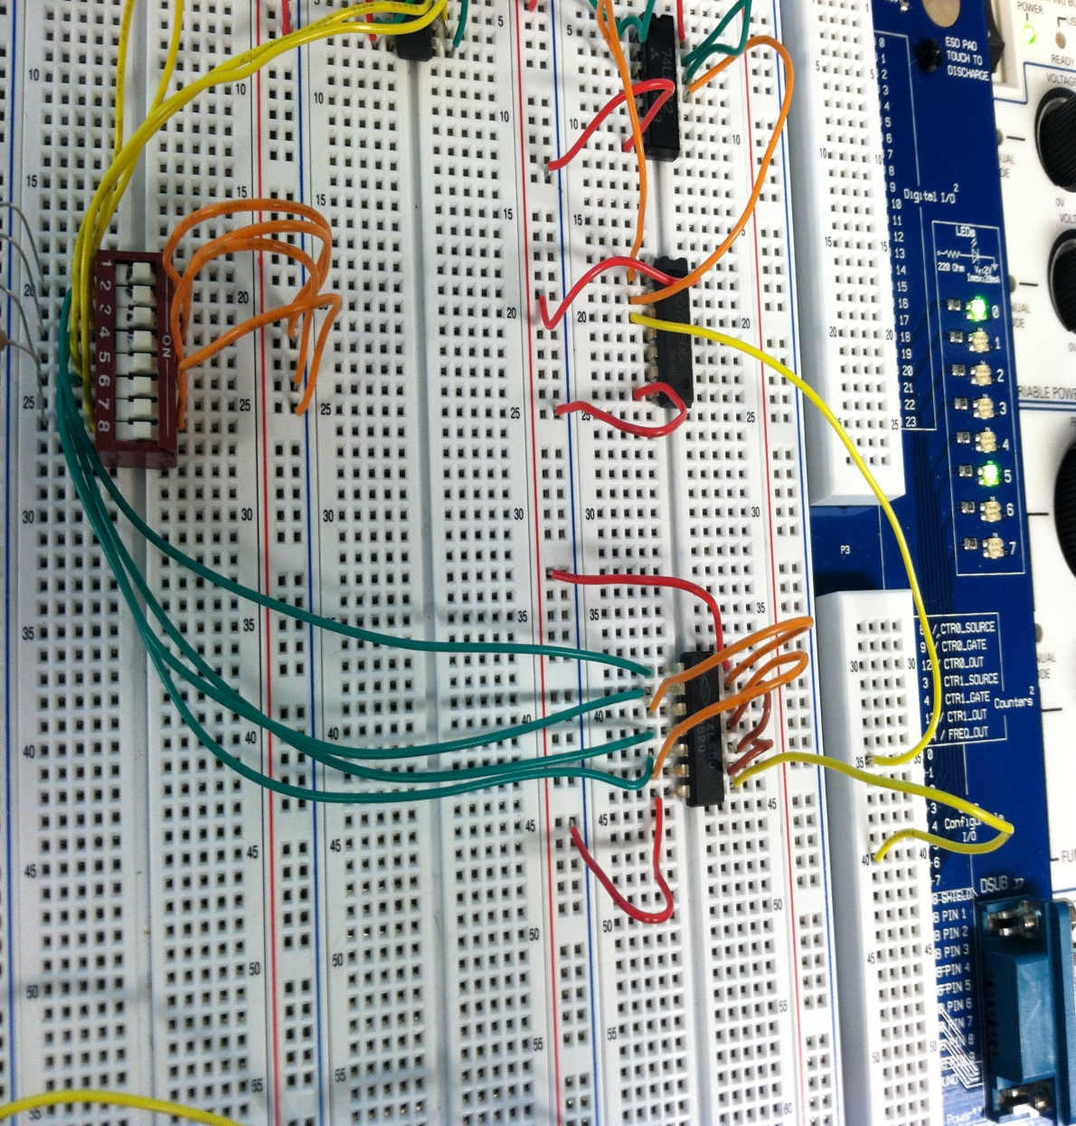
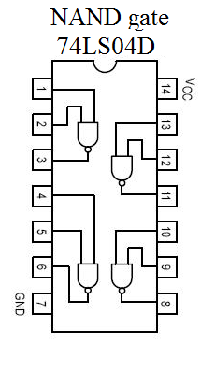
#2 - NAND ALTERNATIVE
In the Lab

Slide 11
#3 - MIDTERM (Car Alarm) in Multisim Using AND, OR, and NAND gates
Create a truth table
Use boolean expression and simplification.
Create schematic in multisim
Build black box.
- Ignition
(D) – Door
(L) - Lights

Slide 12
#3 - MIDTERM (Car Alarm) in Multisim Using AND, OR, and NAND gates
Alarm on if:
Ignition is on and door is open
Ignition is off and lights are on
Door is open and lights are on

Slide 13
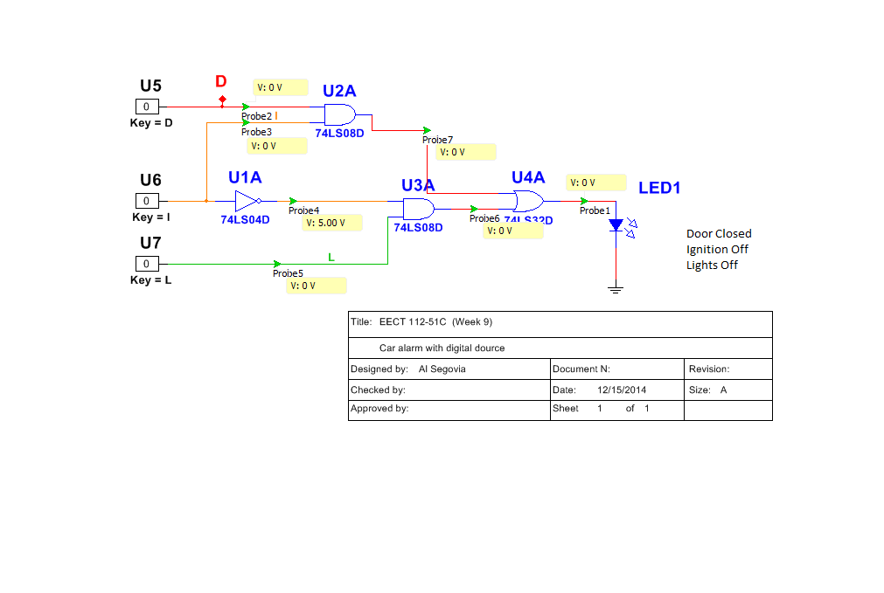
#3 - MIDTERM (Car Alarm) in Multisim Using AND, OR, and NAND gates

Slide 14
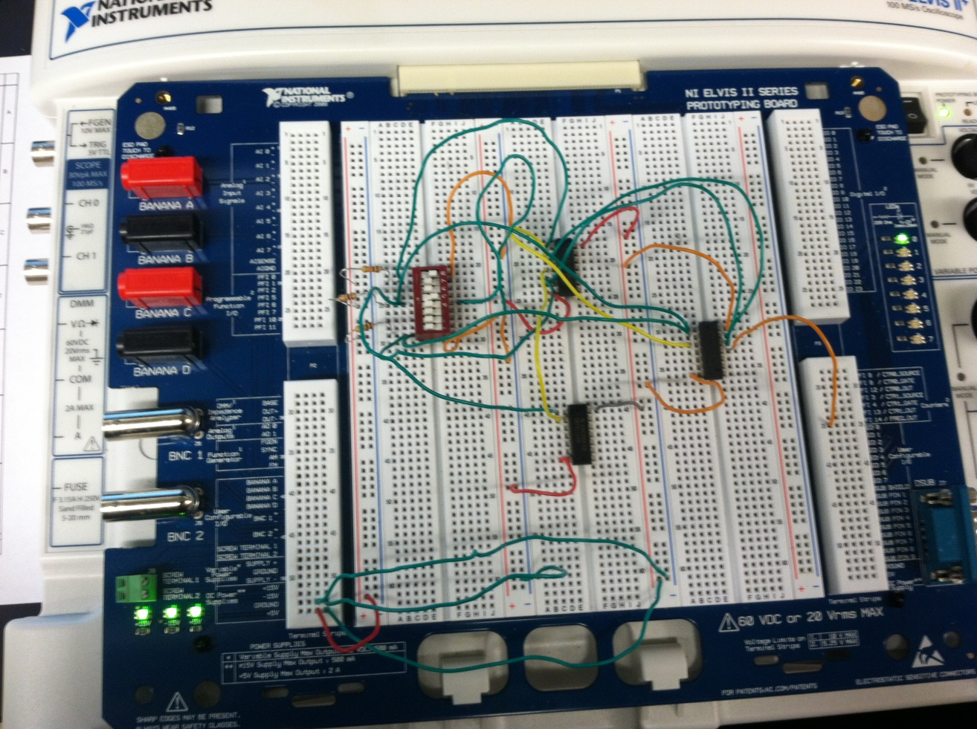
#3 - MIDTERM (Car Alarm) In the Lab

Slide 15
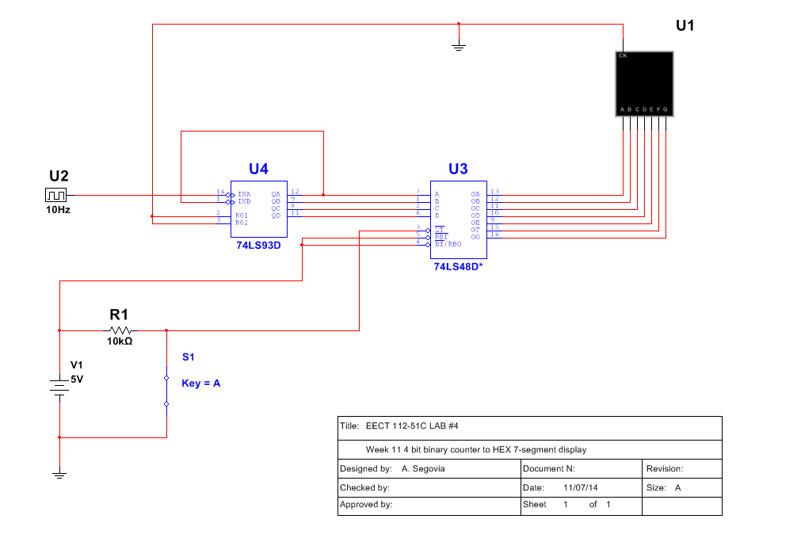
#4 - Binary Counter
Schematic on Multisim

Slide 16
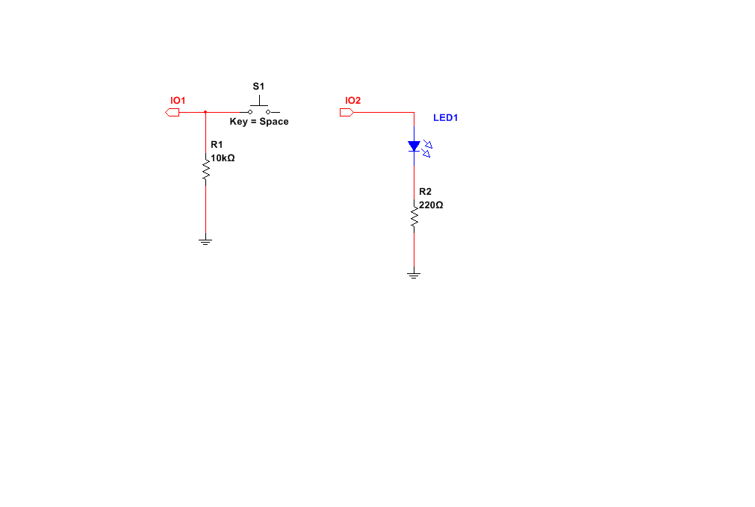
#5 - Basic Stamp
LED Flasher
Schematic on Multisim

Slide 17
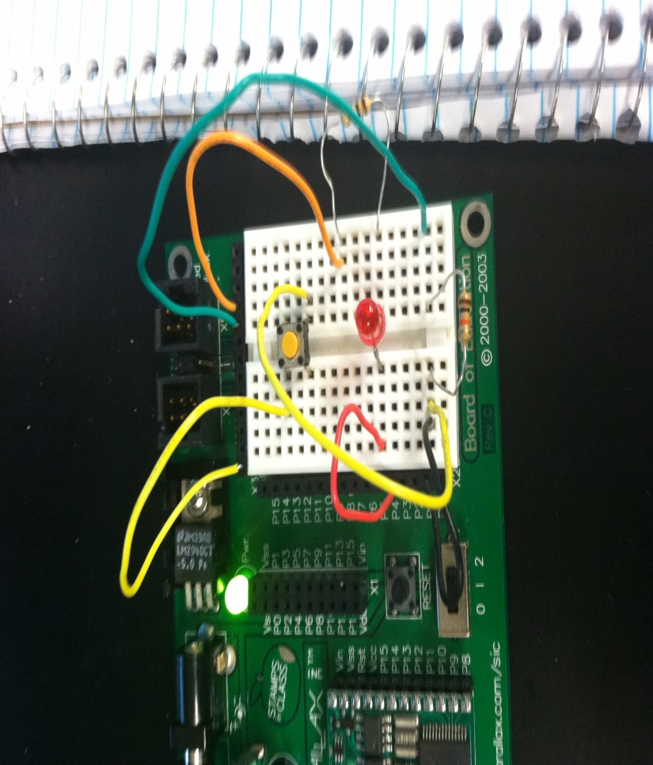
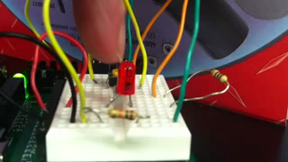
#5 - Basic Stamp
LED Flasher
In the Lab

Slide 18
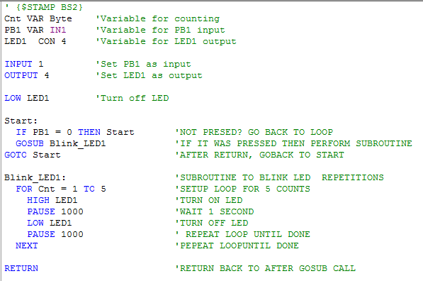
#5 - Basic Stamp
LED Flasher
BASIC Stamp Programing

Slide 19
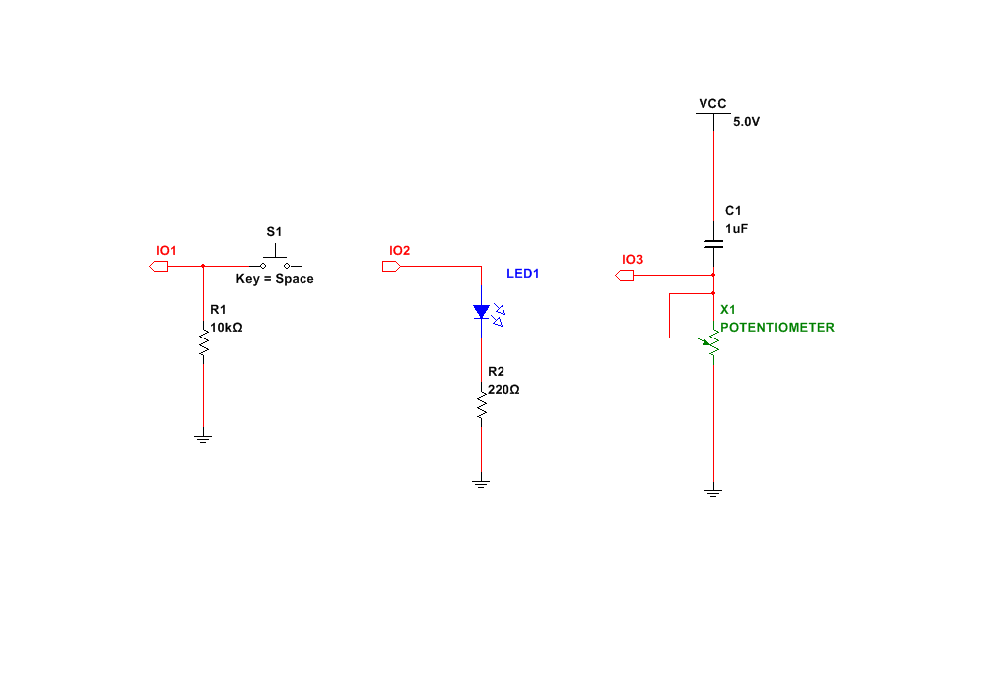
#6 - Basic Stamp
Temp Sensor/Heater
Schematic on Multisim

Slide 20
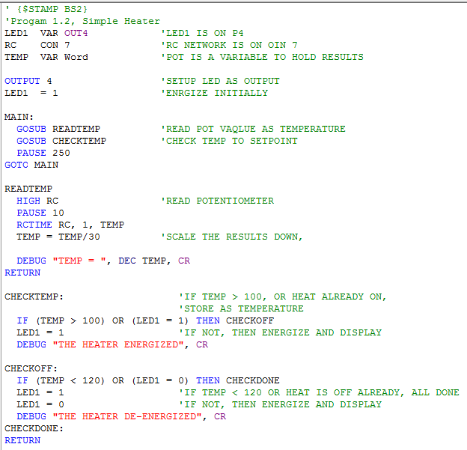
#6 - Basic Stamp
Temp Sensor/Heater
BASIC Stamp Programming

Slide 21
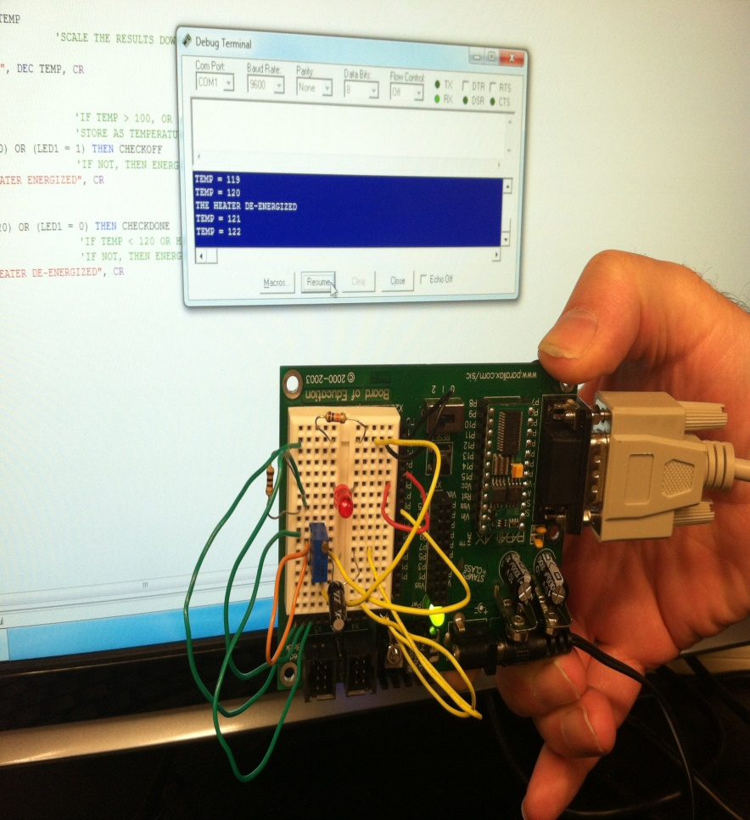
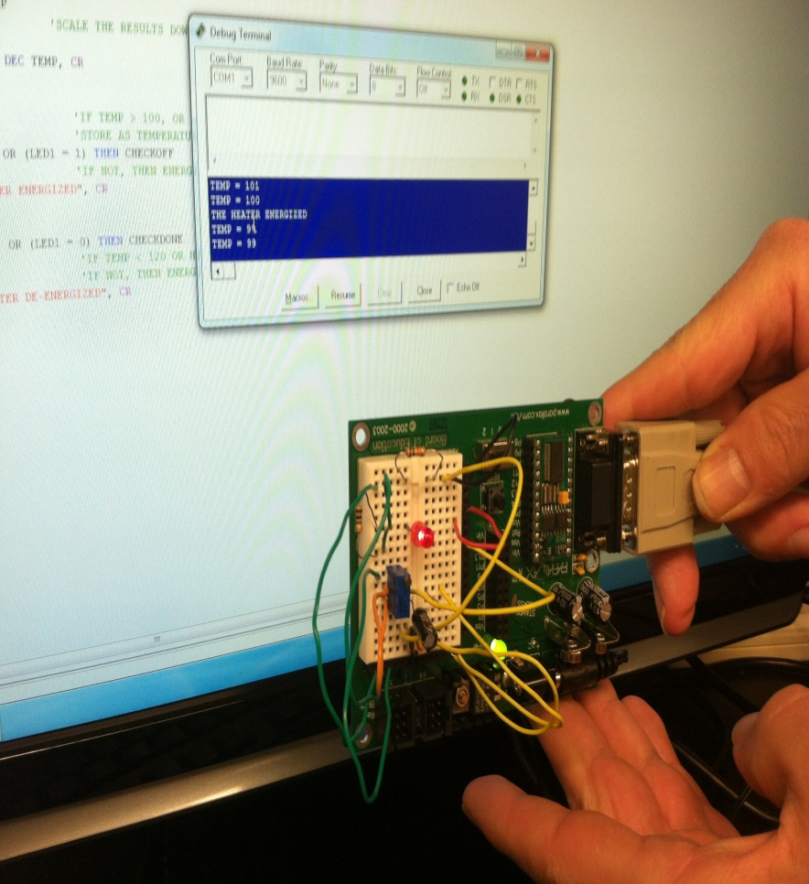

#6 - Basic Stamp
Temp Sensor/Heater
In the Lab

